Slide 1
基于免交叉调节Z线CZ门优化
制作人：李少炜
2017.12.11

Slide 2
绝热CZ门优化
基于算法 | 比特数量 (耦合强度) | 能级排布 （非简谐性） | 基于波形 （调节比特） | 优化参数 | 优化结果 | 最佳波形参数
Nelder Mead | 4 （5MHz） | 4.8G,5.3G 4.7G,5.2G (250M) | UCSB理论计算给出最佳绝热波形 （qubit 2） | 1、脉冲高度 2、门操作时间 3、相邻比特spin echo时间间隔 | 99.723% | max_de=-0.34889GHz t_gate=133.604ns delta_x_gate=60.744ns
 | 4 （5MHz） | 4.7G,5.2G 4.8G,5.3G (250M) |  |  | 99.772% | max_de=-0.14627GHz t_gate=134.855ns delta_x_gate=58.891ns
程序文件：20171213_01_report_spin_echo_multi_qubit

Slide 3
simulation of nonadiabatic CZ gate(2bit 3 level)
Algorithm (Algorithm parameter) | num of qubits (coupling strength) | energy level （Anharmonic） | waveform （driven qubit） | waveform parameter | optimize result | best waveform parameter
DE Algorithm 差分演化算法 （population=25 generation=200） | 2 （12MHz） | 5.3G,4.7G (250M) | waveform （qubit 1） | “x” or “wave_para” (t_gate is dispersed, unit:0.5ns) | 99.991% | t_gate=30.5ns delta=-343.887M 0.5f: 4.277M,6.687M 1f: -5.482M,20.708M 2f: 0.166M,21.927M
x(wave_para):[t_gate,delta1,omgh_sin,omgh_cos,omg1_sin,om12g1_cos,omg2_sin,omg2_cos]
waveform=x[1]+x[2]*np.sin(np.pi*t/t_gate)+x[3]*np.cos(np.pi*t/t_gate)+x[4]*np.sin(2*np.pi*t/t_gate)+x[5]*np.cos(2*np.pi*t/t_gate)+x[6]*np.sin(4*np.pi*t/t_gate)+x[7]*np.cos(4*np.pi*t/t_gate)
程序文件：20171213_02_report_DE_op_z_CZ

Slide 4
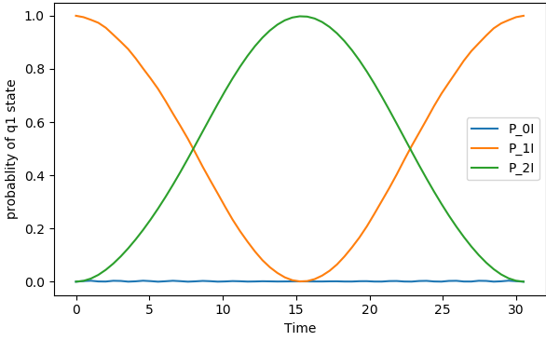
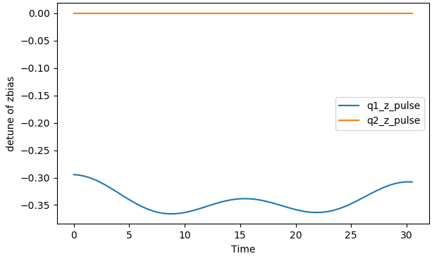
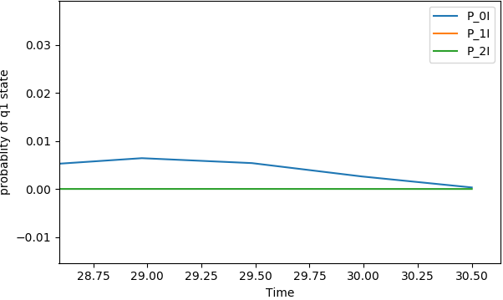
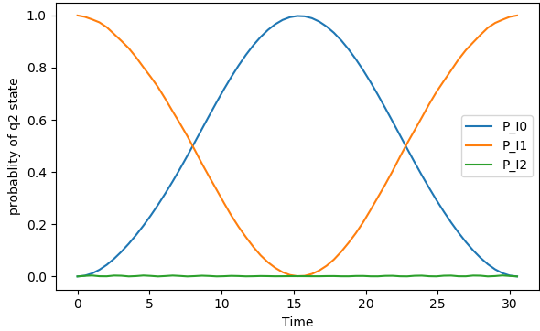
waveform and state evolution
psi0=11（swap with 02）
waveform(detuning z pulse
The peak near 1 shows significant difference from the previous adiabatic waveform (the peak of adiabatic waveform is about 0.5).
The error eventually returns to close to 0. It is not only an adiabatic way to achieve the door, but the non adiabatic way can be achieved as well if we control the period well.
psi0=10：the error tends to 0 at t=30.5ns

Slide 5
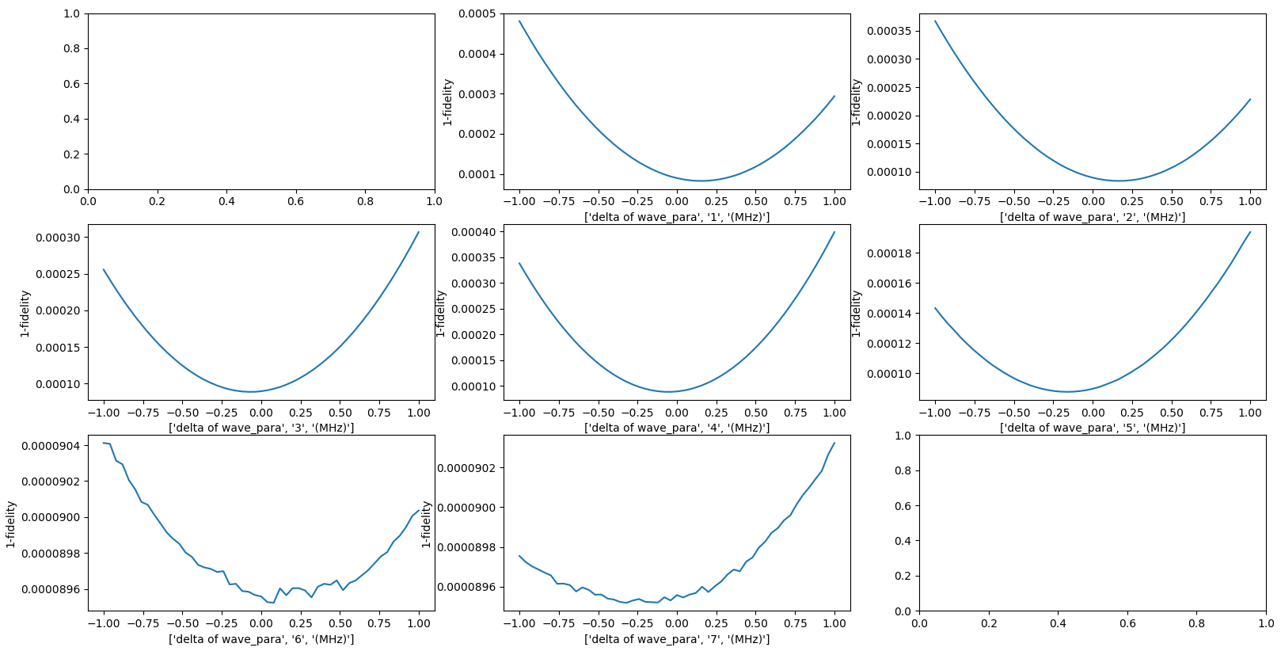
the robustness of wave_pare （The fidelity changes with all the wave_pare except t_gate(All wave_para deviates from -1MHz to 1MHz )）

Slide 6
simulation of nonadiabatic CZ gate (2bit 3 level,include the reponse function)
Algorithm (Algorithm parameter) | num of qubits (coupling strength) | energy level （Anharmonic） | waveform （driven qubit） | waveform parameter | optimize result | best waveform parameter
DE Algorithm 差分演化算法 （population=64 generation=200） | 2 （12MHz） | 5.3G,4.7G (250M) | waveform （qubit 1） | “x” or “wave_para” (t_gate is dispersed, unit:0.5ns) | 99.991% | t_gate=30.5ns delta=-343.887M 0.5f: 4.277M,6.687M 1f: -5.482M,20.708M 2f: 0.166M,21.927M

Slide 7
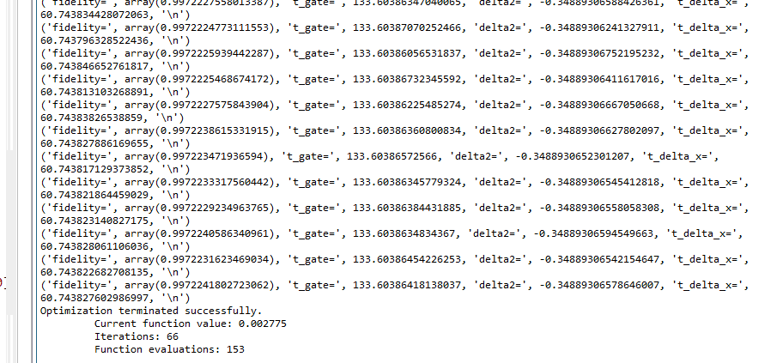
能级：4.8,5.3,4.7,5.2(绝热)

Slide 8
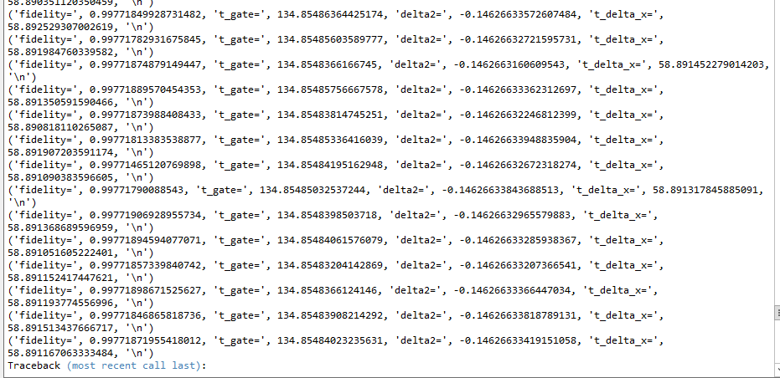
能级：4.7,5.2,4.8,5.3(绝热)

Slide 9
双比特非绝热门仿真
算法 | 能级 | 耦合强度
DE算法 | [5.3,4.7](GHz) | 12MHz
x(wave_para):
[t_gate,delta1,omgh_sin,omgh_cos,omg1_sin,om12g1_cos,omg2_sin,omg2_cos]
waveform=x[1]+x[2]*np.sin(np.pi*t/t_gate)+x[3]*np.cos(np.pi*t/t_gate)+x[4]*np.sin(2*np.pi*t/t_gate)+x[5]*np.cos(2*np.pi*t/t_gate)+x[6]*np.sin(4*np.pi*t/t_gate)+x[7]*np.cos(4*np.pi*t/t_gate)

